Slide 1







MeshCentral
2
HARDWARE TLS
Built with modern web technologies

Slide 2
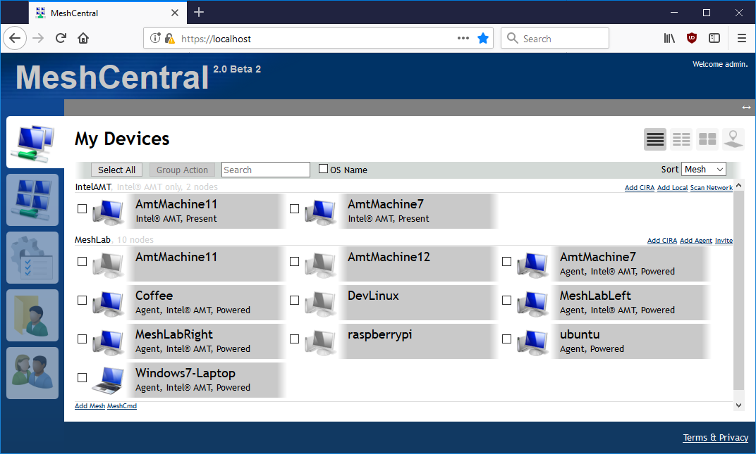
2
MeshCentral
Manage Devices
See all your computers on one web site.

Slide 3
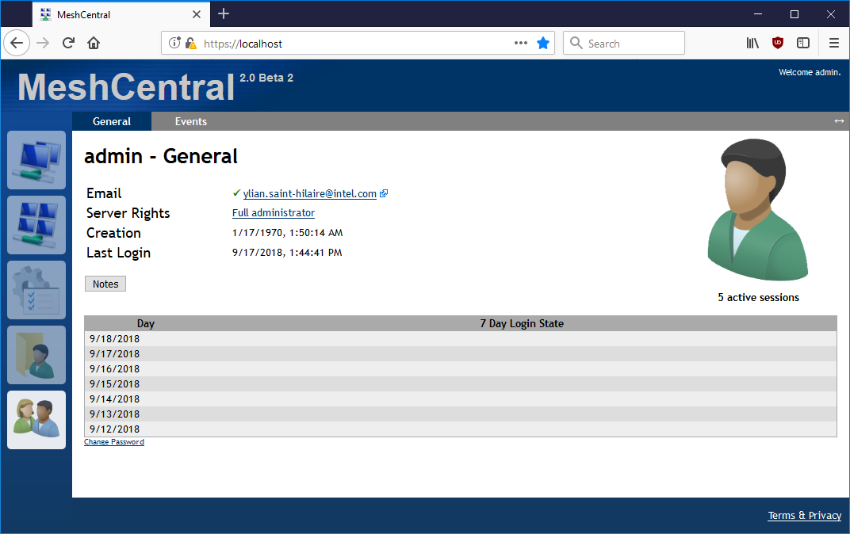
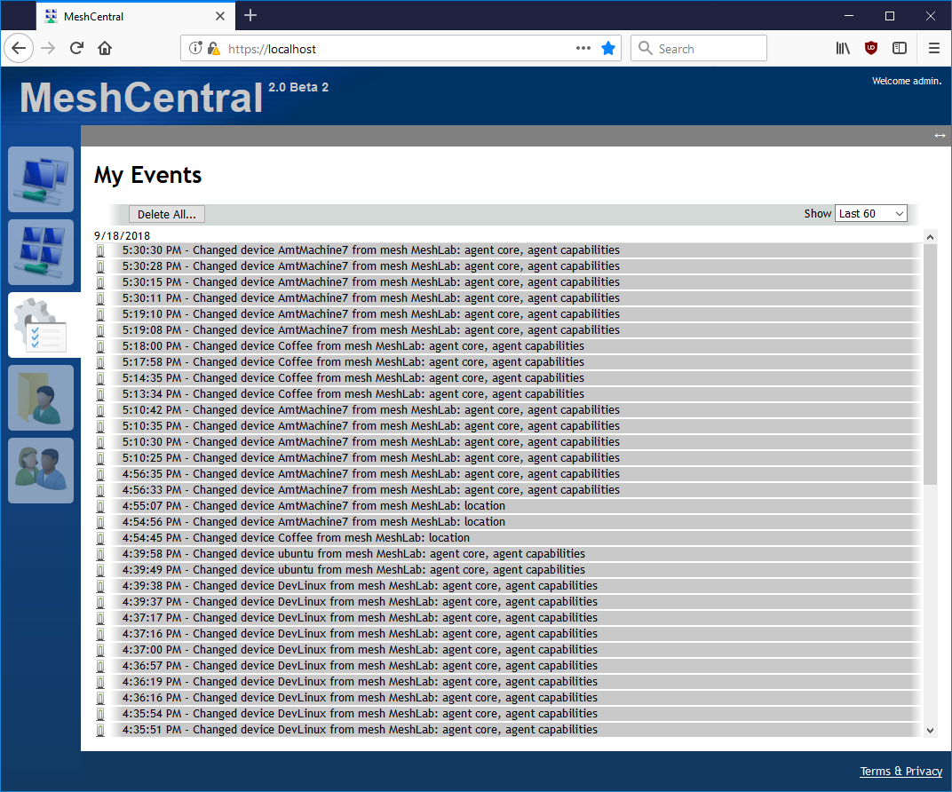
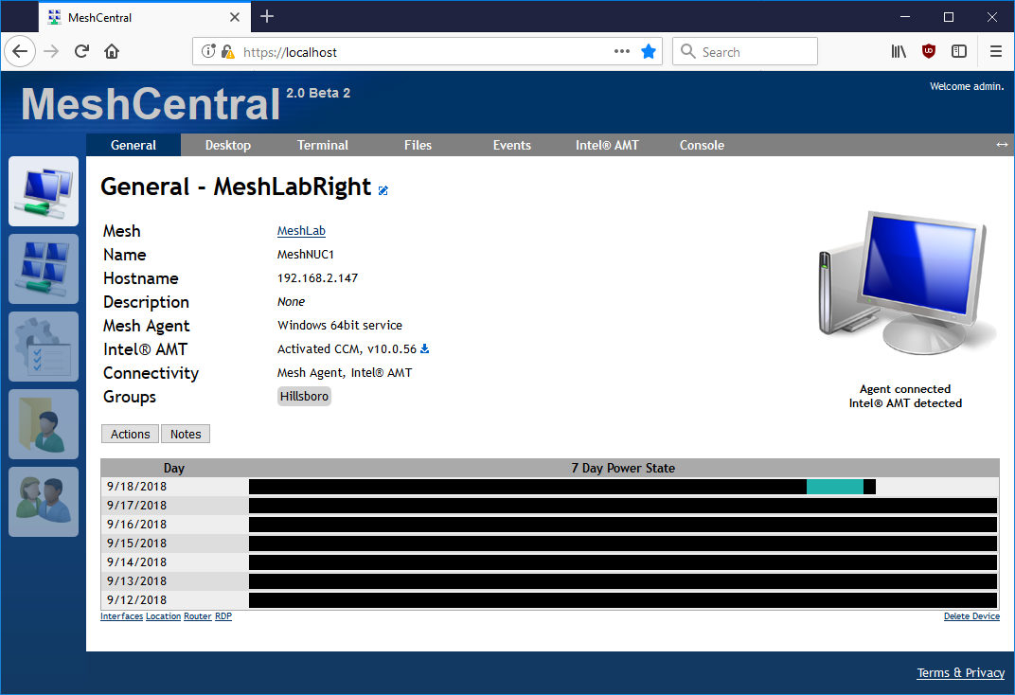
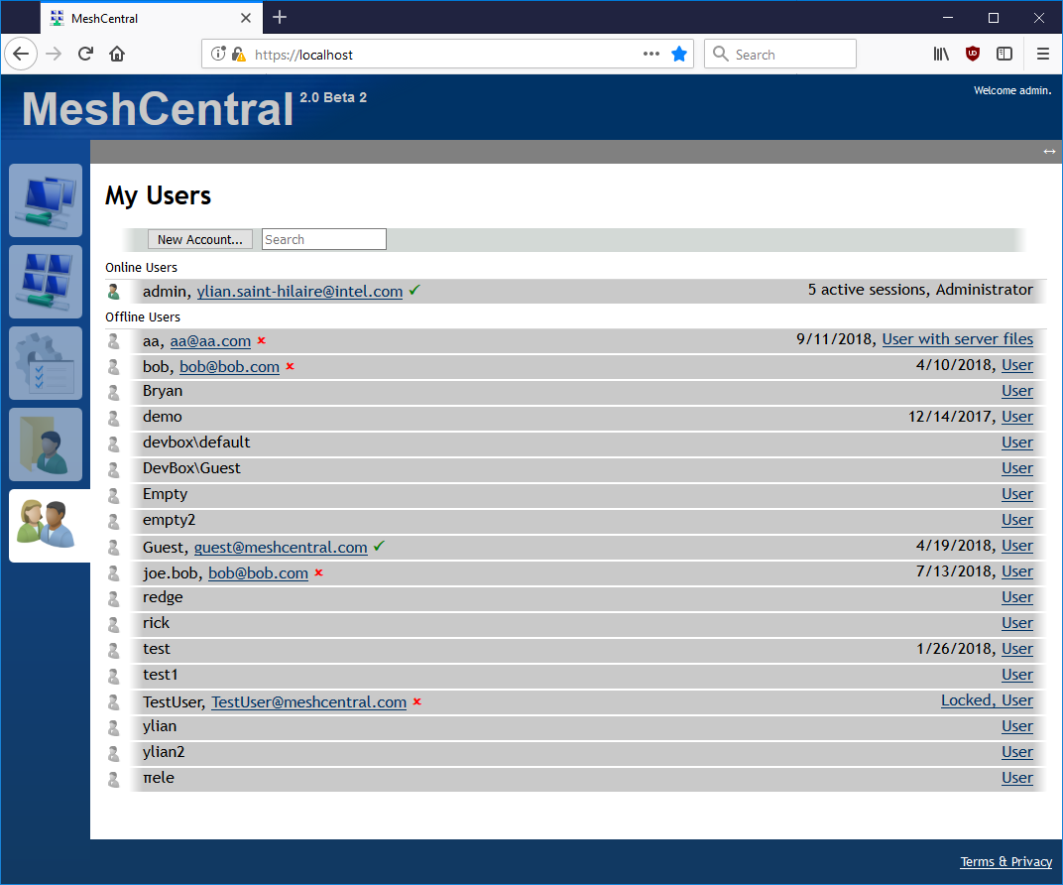
2
MeshCentral
Real Time Interface
No Refresh. Everything shown as it happens.

Slide 4
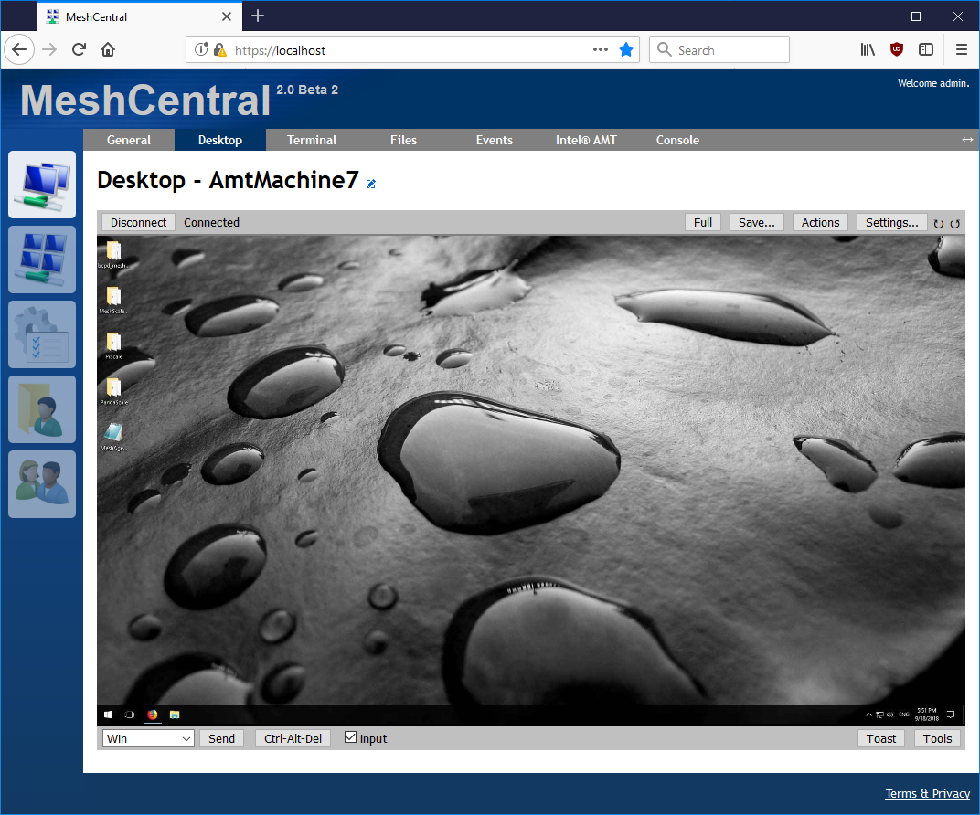
2
MeshCentral
Remote Desktop
Control your computers over the Internet.

Slide 5
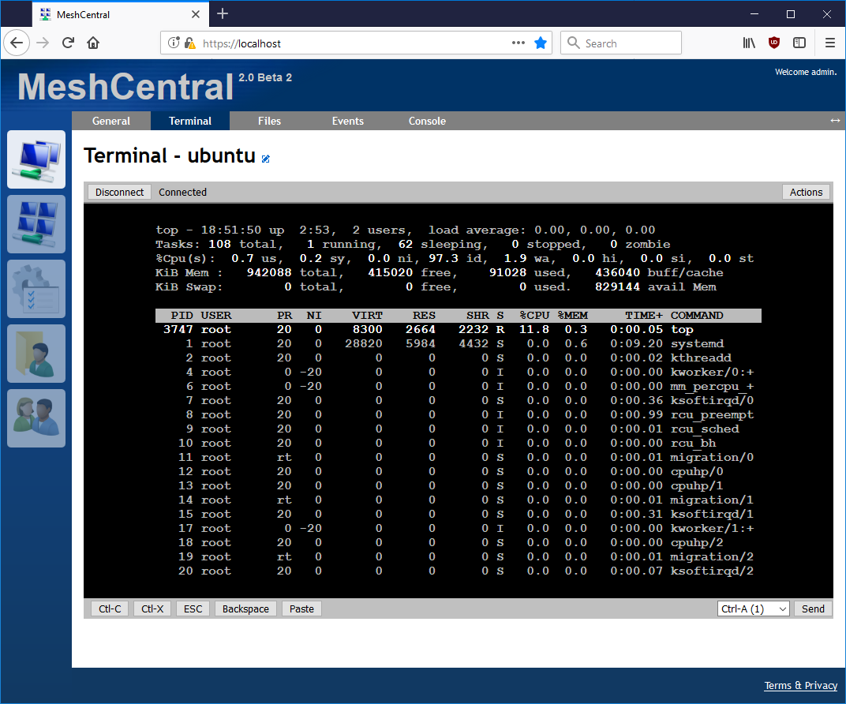
2
MeshCentral
Remote Terminal
Shell access to Linux and Windows.

Slide 6
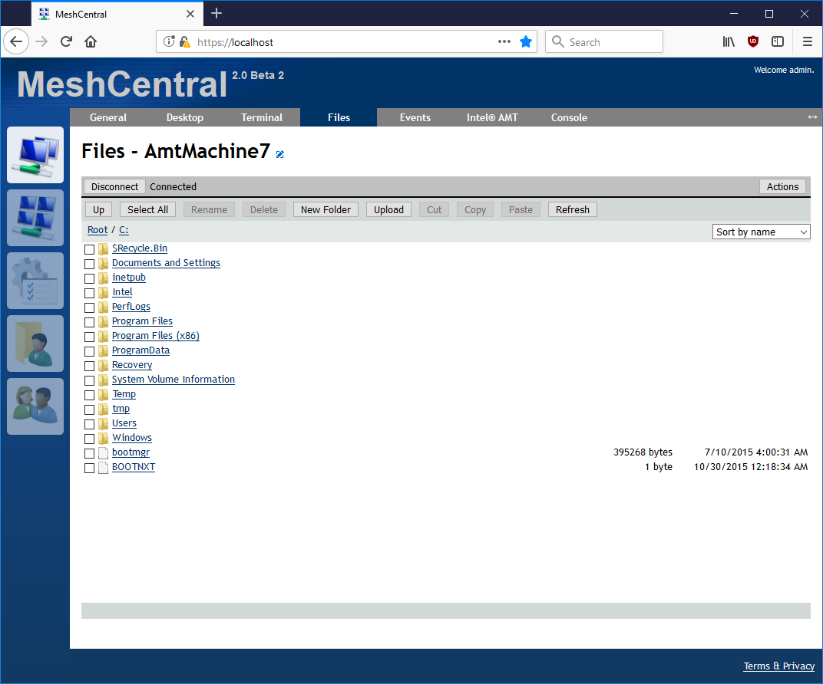
2
MeshCentral
Remote Files
Transfer files to any device.

Slide 7
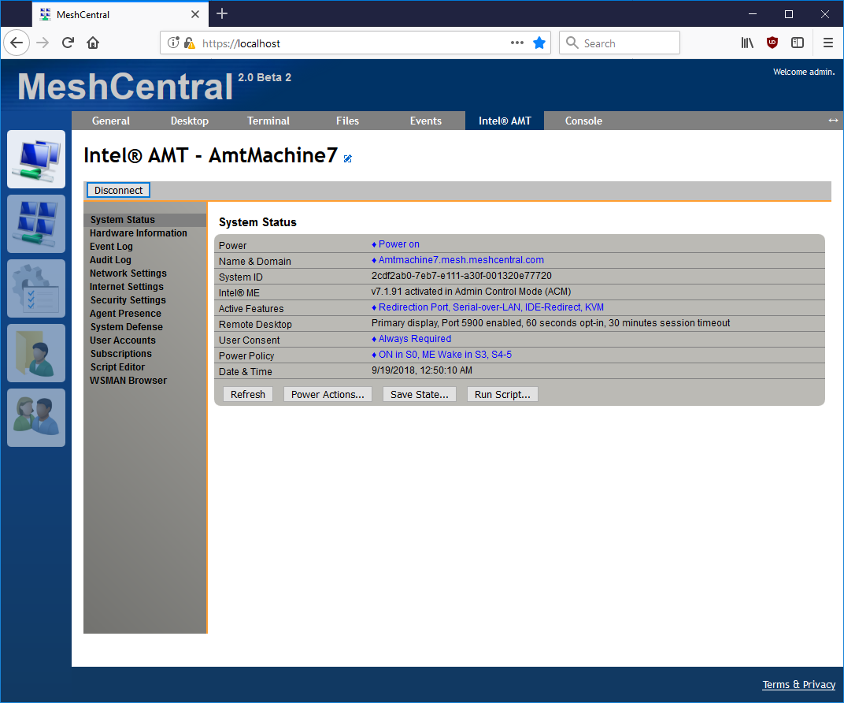
2
MeshCentral
Intel® AMT support
Over-the-Internet hardware management.

Slide 8


2
MeshCentral
Deploy Fast
Deploy to Linux & Windows.
Supports Docker.

Slide 9



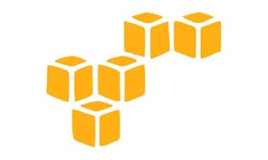

2
MeshCentral
Deploy Anywhere
Standalone, appliance or cloud.
AWS, Google, Azure.
®
®
®
®

Slide 10



Scale More
With Server Peering, MongoDB and TLS Offload.
HARDWARE TLS
2
MeshCentral

Slide 11
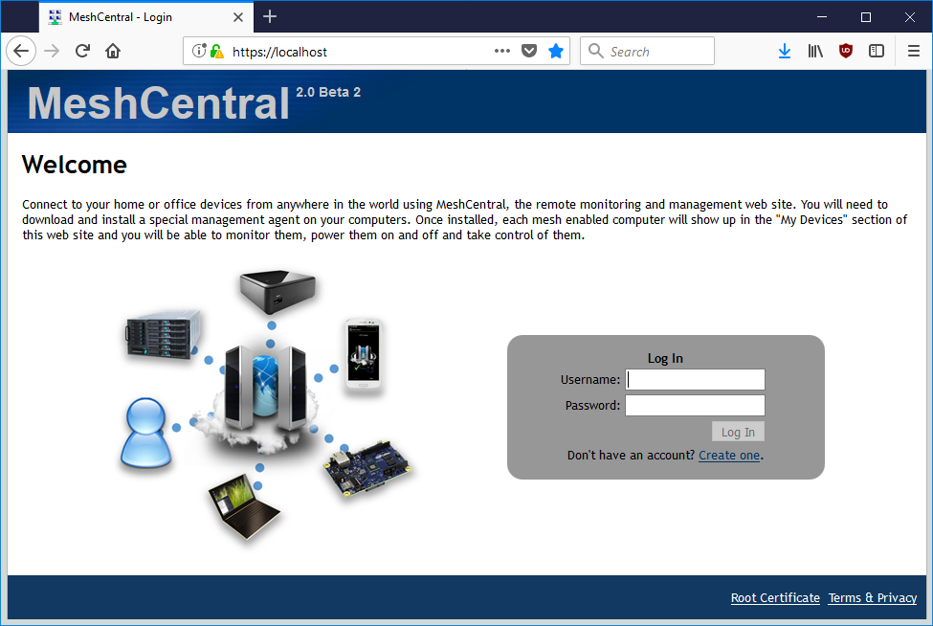
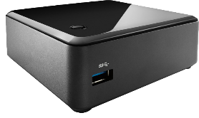

2
MeshCentral
Web Application
Server
Agent
2
MeshCentral
TLS + Web Socket + JSON
TLS + Web Socket + JSON
JavaScript
on browser
JavaScript
on NodeJS
JavaScript
on Duktape
C / C++

Slide 12
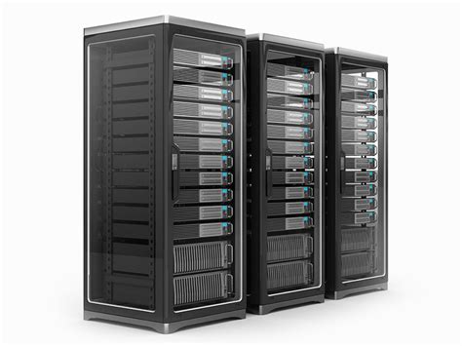



2
MeshCentral
Application
Runtime
MeshCentral v1
Application
Hosting
Application
Hosting
Operating System
Operating System
Operating System
Physical Server
Virtual Server
Container Hosting
NodeJS Hosting

Slide 13
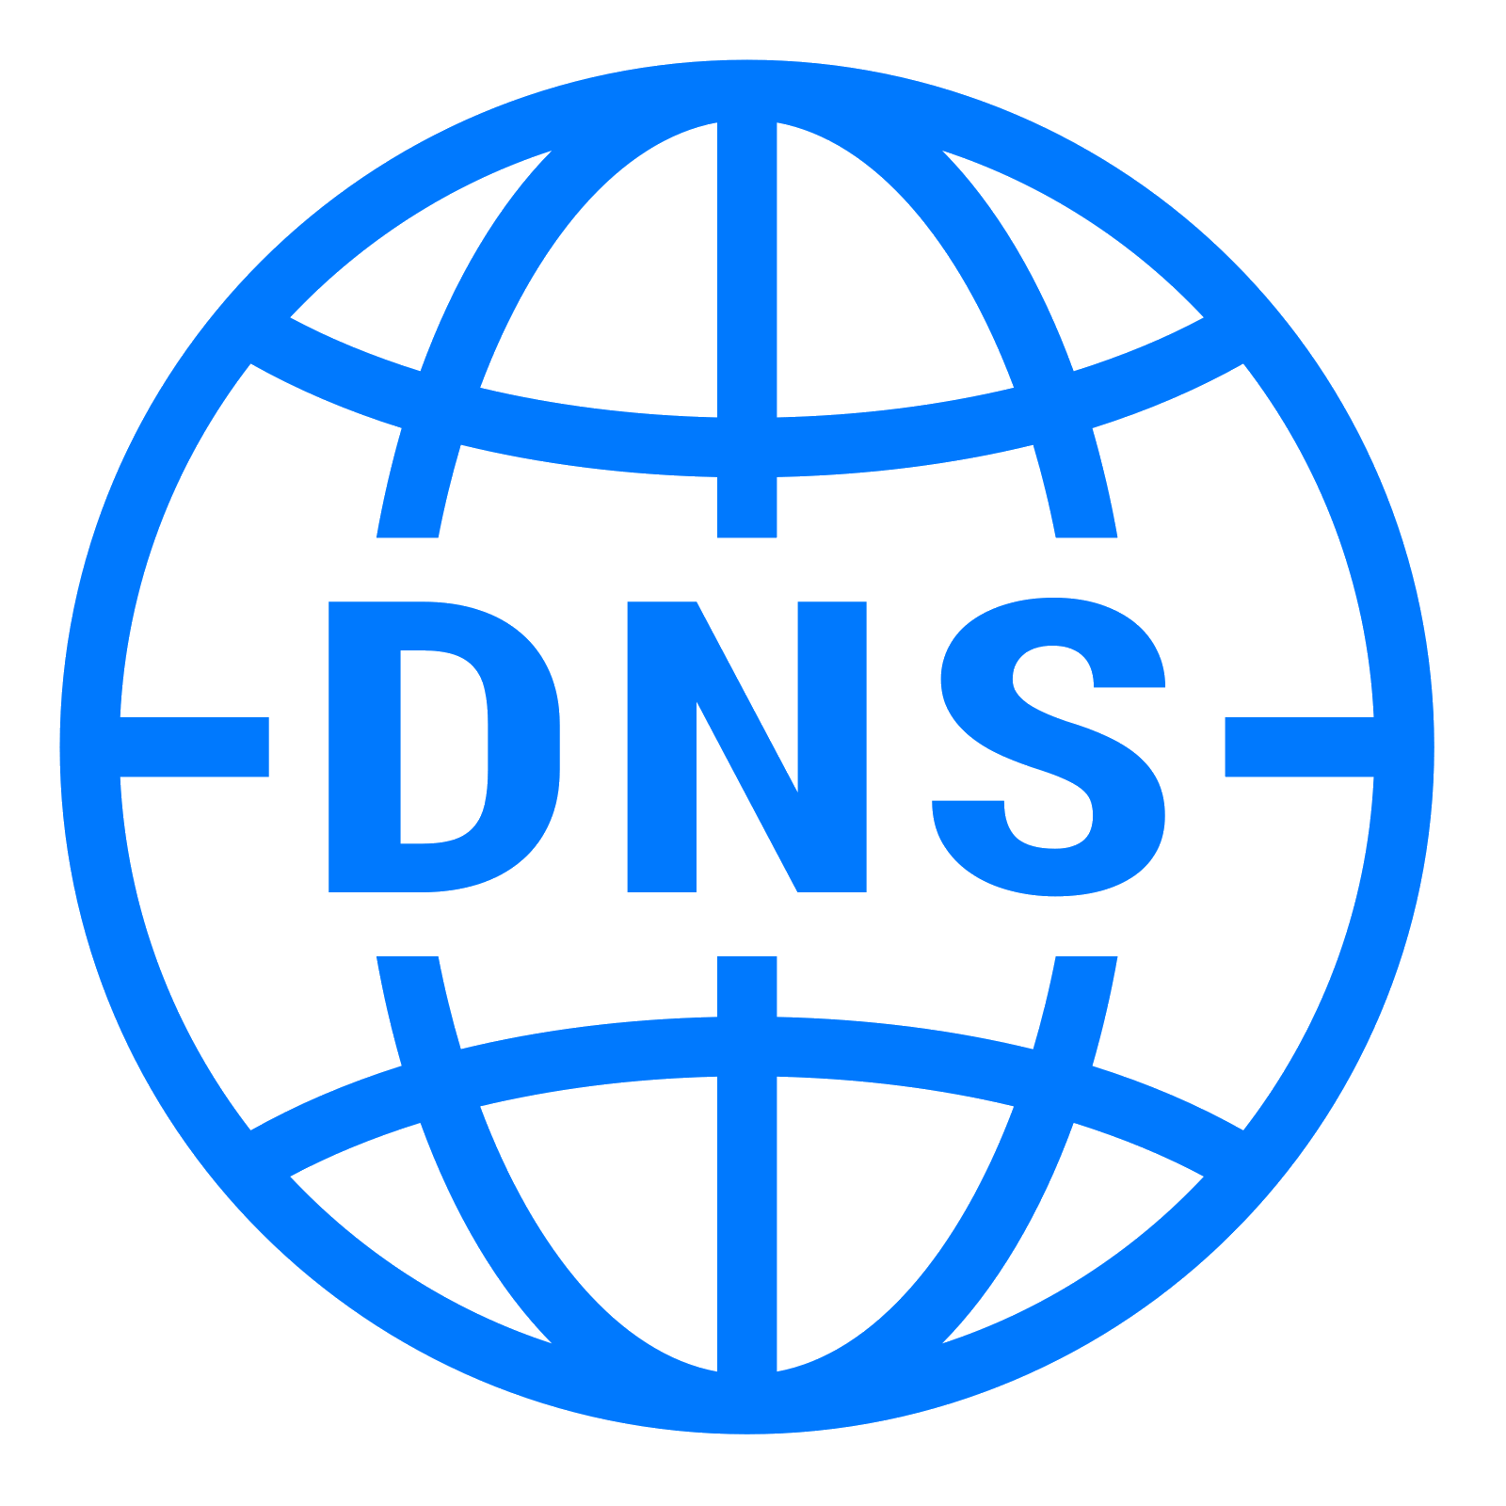


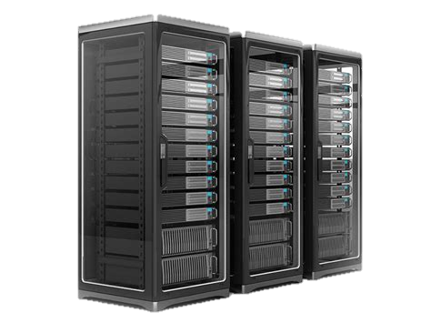
2
MeshCentral
mesh.org.com
files.org.com
www.org.com
Private IP address
y.y.y.1
Reverse Proxy
File Server
Public IP address
x.x.x.x
Private IP address
y.y.y.2
Ports 80 and 443
are shared.
Web Server
mesh.org.com
Private IP address
y.y.y.3

Slide 14
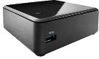


TLS Setup
Web Certificate
Agent Server Certificate
Agent
1
2
Secondary Check
MeshCentral need the hash of the web certificate.
Web Certificate
TLS Setup
Agent Server Certificate
Agent
1
Reverse
Proxy
2
Secondary Check

Slide 15
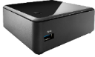
#1 Server Authentication Request, Length = 98
#1 Agent Authentication Request, Length = 98
1
Web Cert Hash
Server Nonce
1
Web Cert Hash
Agent Nonce
2 (0 to 2)
48 (2 to 50)
SHA386
48 (50 to 98)
Random Number
2 (0 to 2)
48 (2 to 50)
SHA386
48 (50 to 98)
Random Number
#2 Server Signature, Variable length
#2 Agent Signature, Variable length
2
Len
Server AG Cert
Server Signature
2
Len
Agent Cert
Agent Signature
2 (0 to 2)
2 (2 to 4)
48 (4 to Len + 4)
X509 certificate
48 (Len + 4 to end)
PKCS9 signature
2 (0 to 2)
2 (2 to 4)
48 (4 to Len + 4)
X509 certificate
48 (Len + 4 to end)
PKCS9 signature
#4 Agent Authenticated
#3 Agent Information, Length = 72 or more
4
3
InfoVersion + AgID + AgVer + Platform
MeshID
Caps
LEN + Name
2 (0 to 2)
2 (0 to 2)
16 (2 to 18)
48 (18 to 66)
SHA386
4 (66 to 70)
Len (2) + Name
#4 Server Pre-Authenticated
4
2 (0 to 2)
#5 Expected ServerID, Length = 34 or 50
1
ServerID
2 (0 to 2)
32 or 49
SHA256 or SHA386

Slide 16
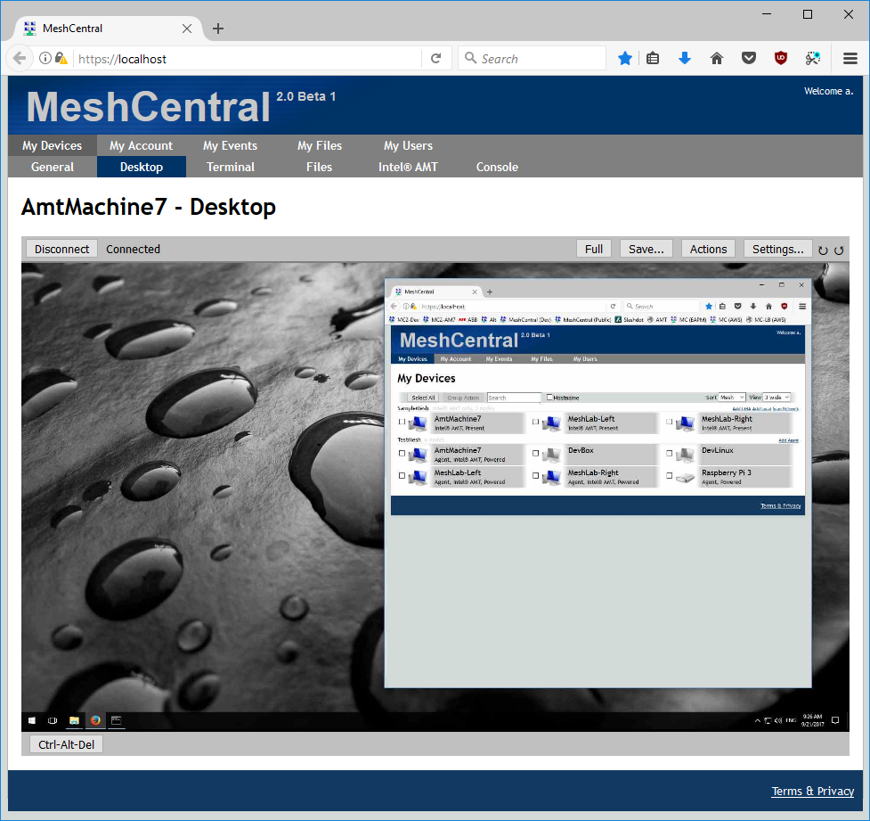
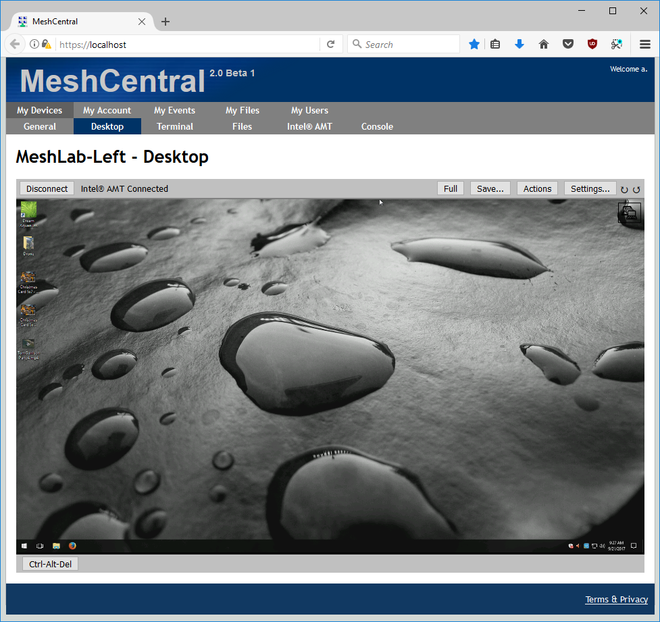
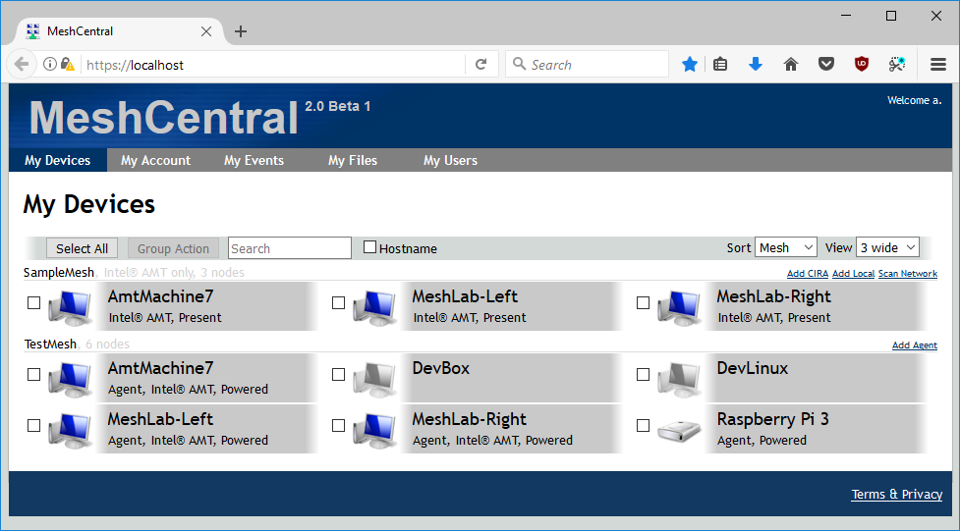






Mesh Agent² Soft-KVM
Intel® AMT Hardware KVM
Perform software and hardware remote desktop sessions to computers on both servers.
Server Peering
TLS / Web Socket
Users connected on either server see a real-time combined view of both servers.
All connections except for Intel® AMT CIRA are secure web socket on port 443.
2
2
MeshCentral
MeshCentral
Intel® AMT CIRA
Intel® AMT CIRA
Mesh Agent
Mesh Agent

Slide 17
2
2
MeshCentral
MeshCentral
Load-balancer setup
Multi-Geo setup
Single IP address exposed publically
TLS offload
TLS offload
Load-Balancer
TLS offload
TLS offloaded is supported but optional
Each server has it’s own public IP address.
New with MeshCentral² Support for TLS offload on CIRA connections.

Slide 18

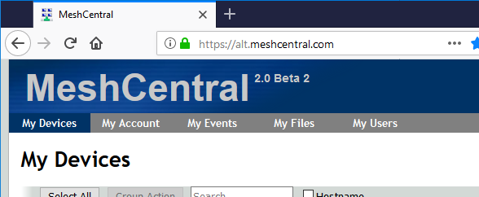

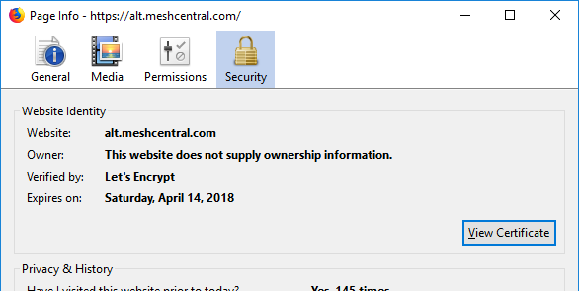
2
MeshCentral
Register
Prove domain control HTTP:80
Get HTTPS certificate
meshcentral-data
letsencrypt
…
Let’s Encrypt files and certificates will be located in the data folder.

Slide 19
Fast, Real-time interface.
Web Application
Loaded once over HTTPS
MeshCentral
2
Two way traffic
Secure Web Socket

Slide 20
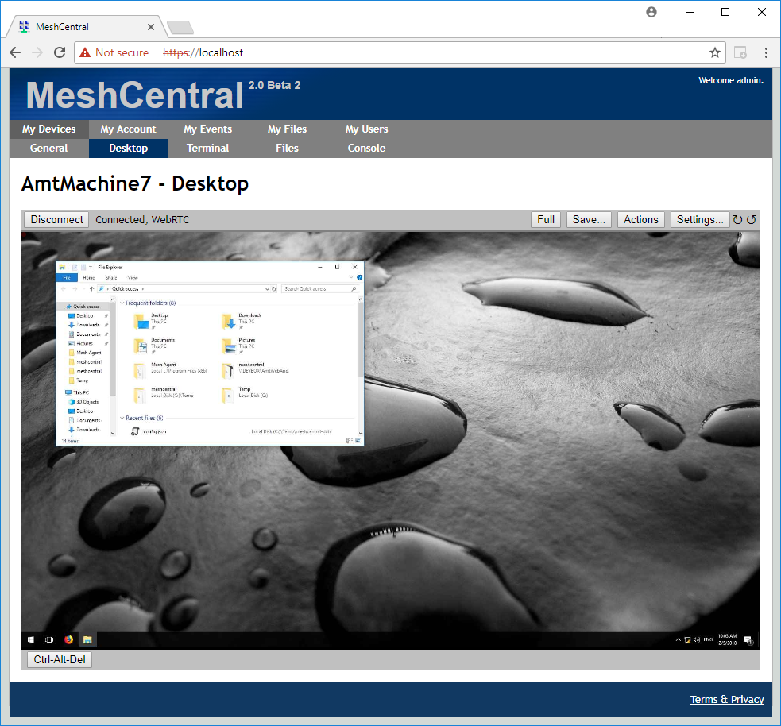
Web Socket Relayed thru the server
MeshAgent²
WebRTC Browser to agent direct
MeshAgent²
Ask for session
Session URL
Session URL
Web Socket Connect
Web Socket Connect
Web Socket Connect
Web Socket Connect
Session data + WebRTC setup messages
WebRTC Connect
WebRTC Connect
Notify WebRTC connection
WebRTC switch-over messages (Switch + ACK on both sides)
Web Socket messages
Session data over WebRTC
WebRTC messages

Slide 21
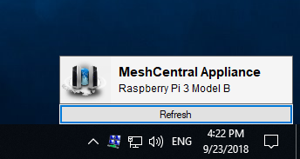
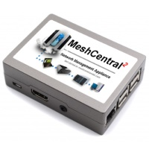
WAN Mode Server must have a fixed DNS name.
Perfect for Internet deployments.
LAN Mode No fixed server IP or name.
Perfect for local networks.
MeshAgents & Intel® AMT connect to the server
at a know IP/name
Server can connect
directly to Intel® AMT
Mesh Agents multicast
on the LAN to find
the server.

Slide 22
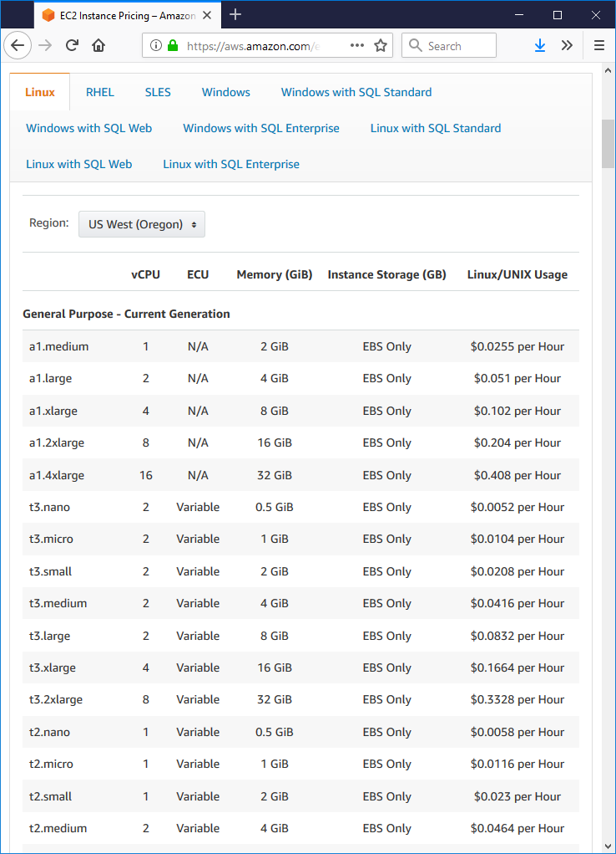
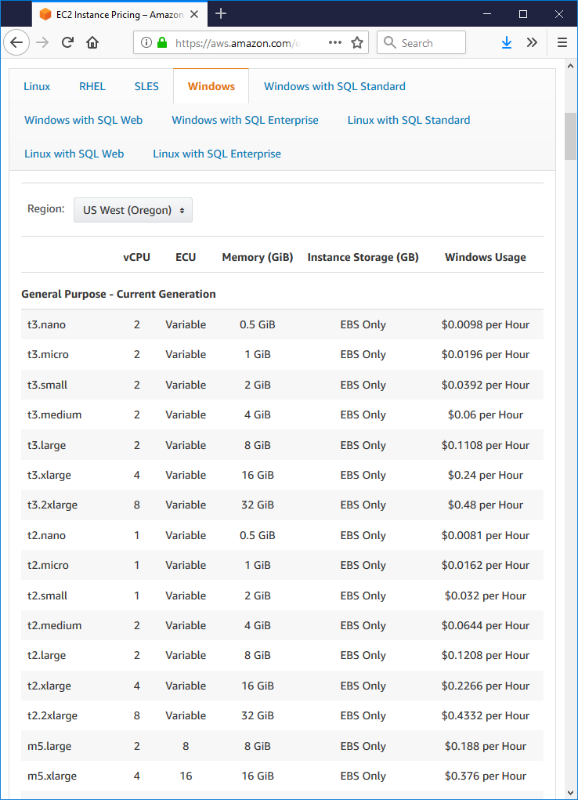
MeshCentral v1
2
MeshCentral
3.74 $ / mo
15 $ / mo
173 $ / mo

Slide 23
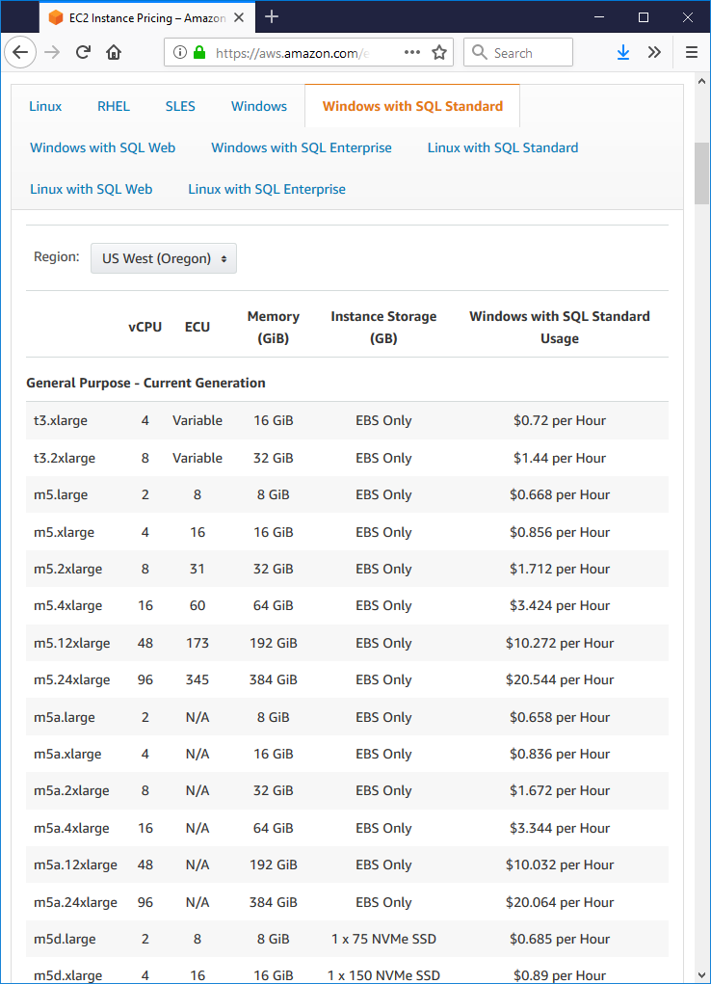
MeshCentral v1
2
MeshCentral
15 $ / mo
519 $ / mo

Slide 24
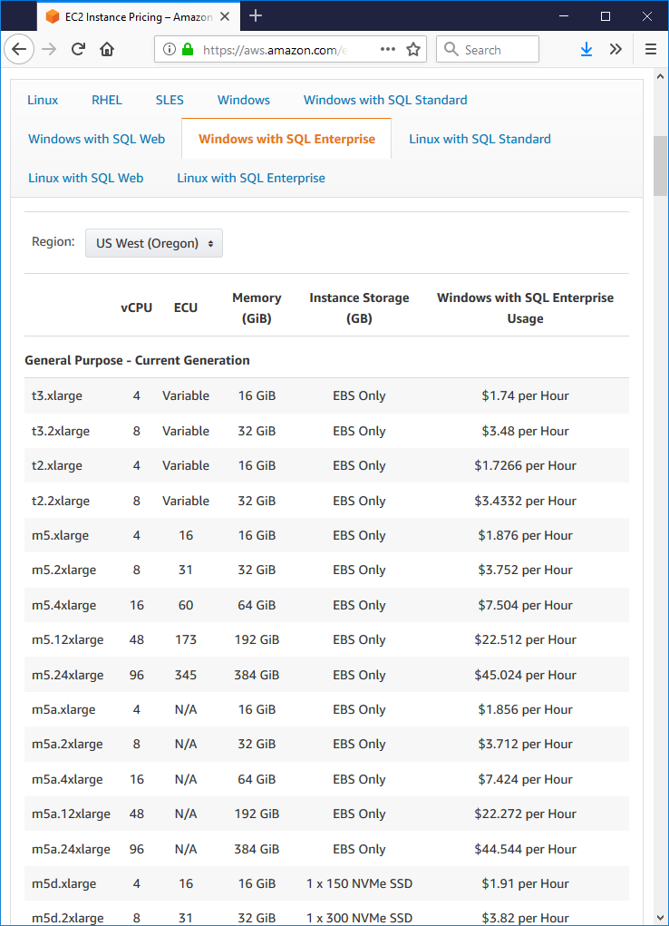
MeshCentral v1
2
MeshCentral
239 $ / mo
1253 $ / mo

Slide 25
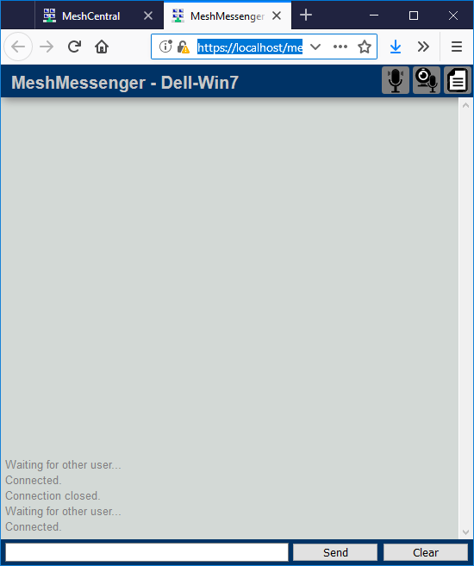
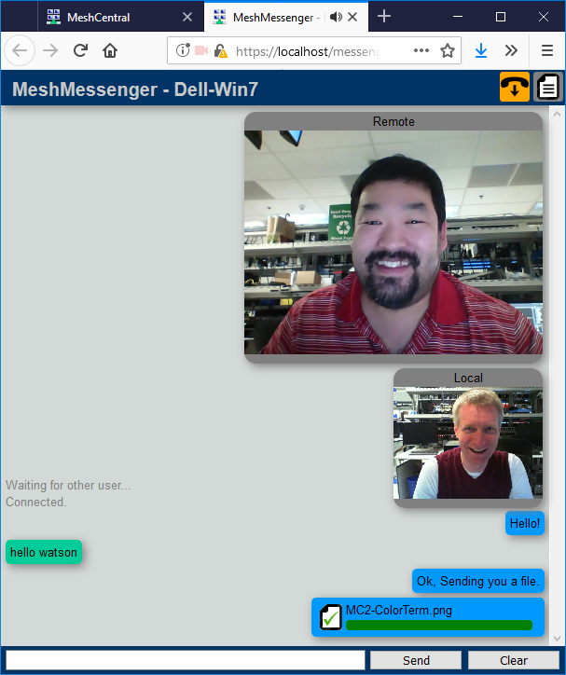

Once connected, WebRTC will be setup for direct browser-to-browser connection.
In addition to file transfer
if WebRTC is successful,
the audio/video icons will appear.
Local and remote windows show the chat session in real time.
Once received, click on the file to save it on the local computer.
Drag & drop a file to send it over.

Slide 26
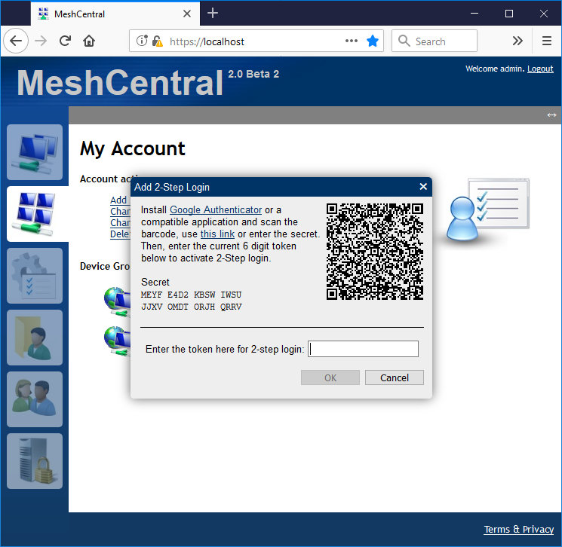
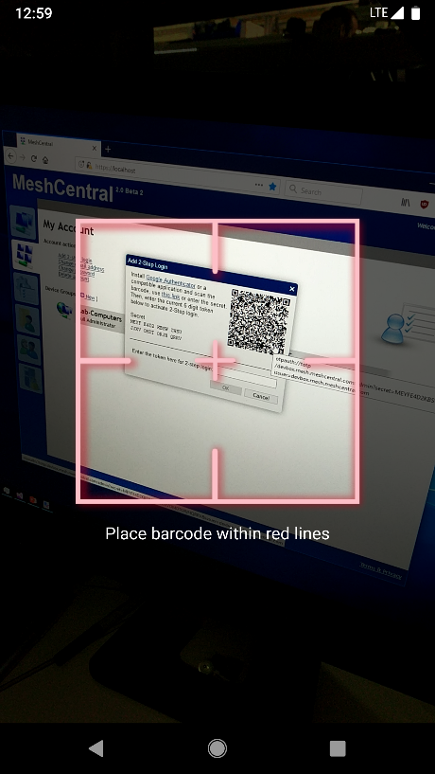
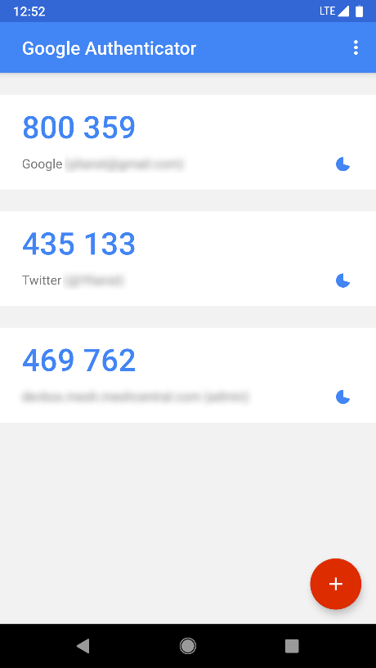
2
Use Google Authenticator
to scan the QR code.
1
In the “My Account” tab, click on “Add 2-step login”.
3
Enter the time token back into MeshCentral to complete setup.

Slide 27
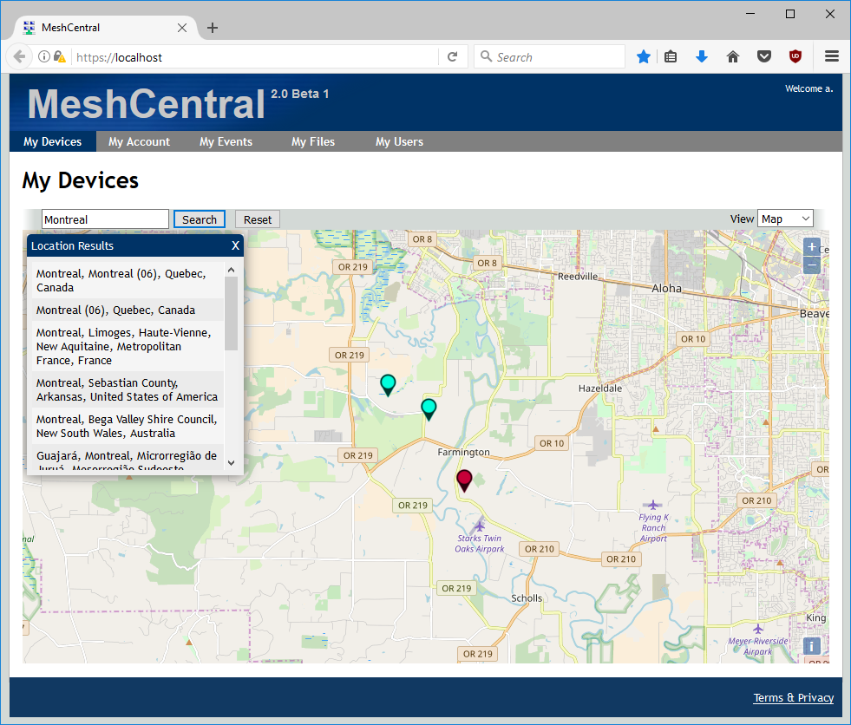
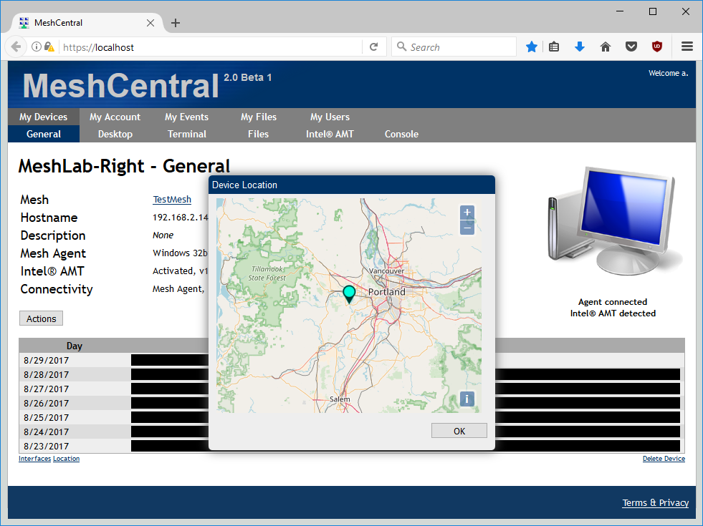

Slide 28
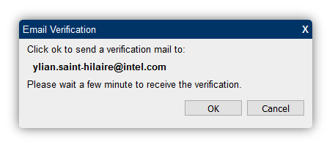
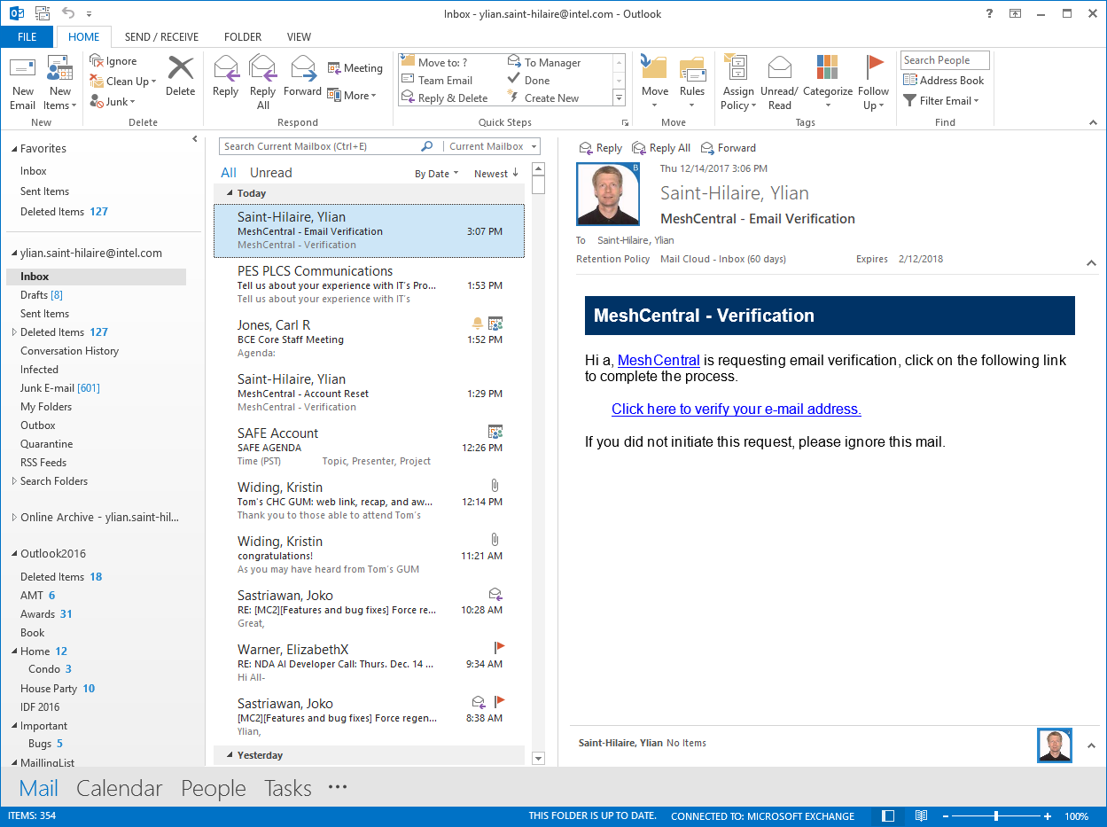
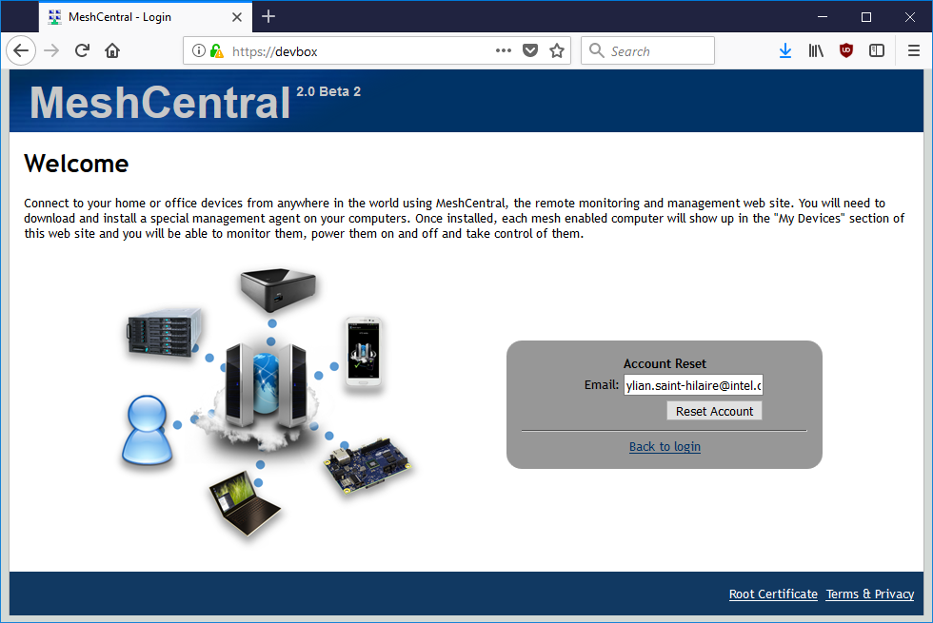
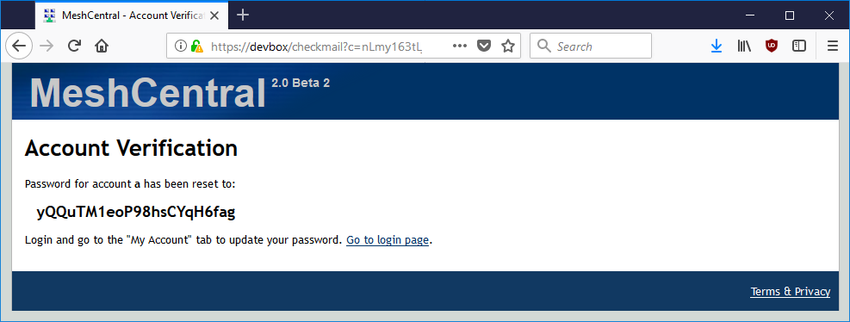
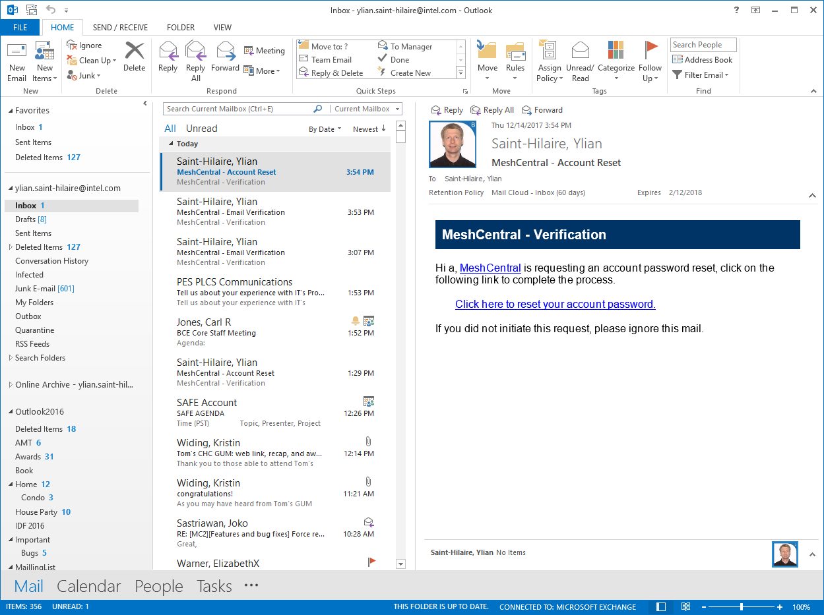
Email verification
2
MeshCentral
Account Reset

Slide 29
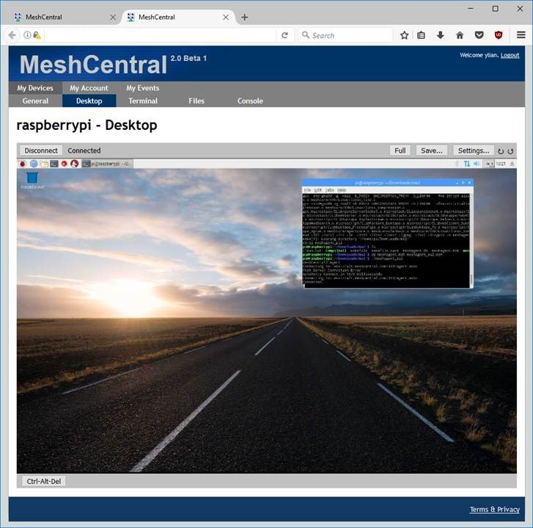
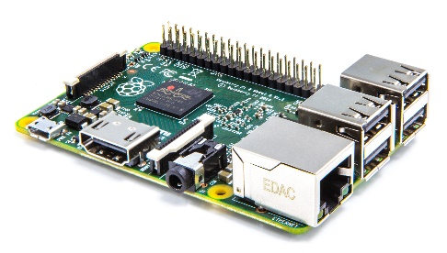
IoT Device
Windows / Linux / OSX
2
MeshCentral

Slide 30

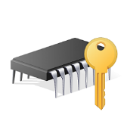

2
Optional TPM
MeshCentral
Server Root
Agent
Agent Root
MPS cert
Secondary Cert
Web Cert
Agent Cert
Mesh Agent with certificate hardening
Mesh Agent without hardening
TPM
Agent Root
Agent to server authentication
Agent Root
Agent to server authentication
WebRTC authentication
WebRTC authentication
Secondary Cert

Slide 31
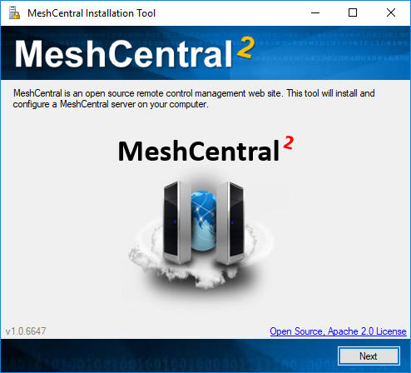
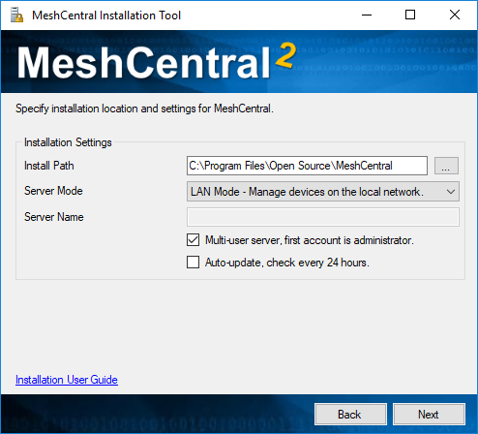
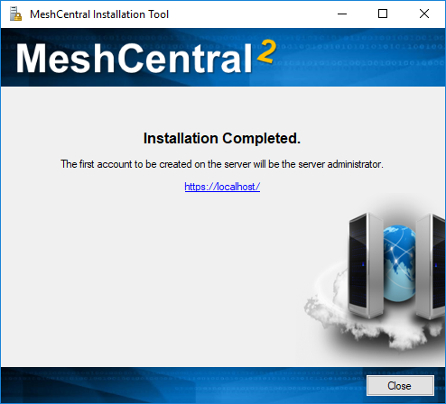
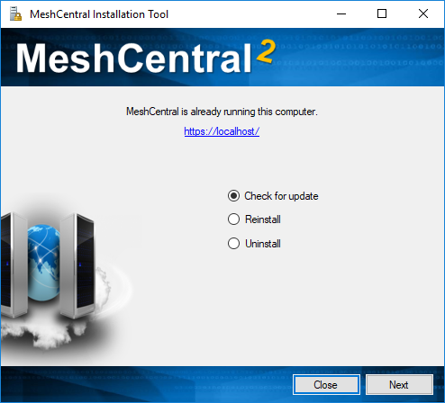
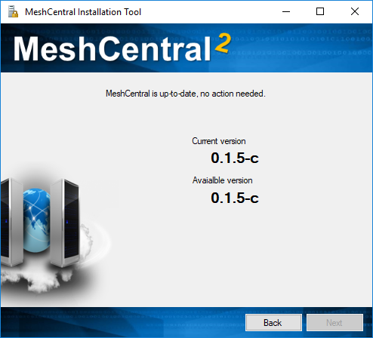

Slide 32
MeshCentral
2
HARDWARE TLS
MeshCommander.com

